Slide 1
CI/CD - Jenkins

Slide 2
Agenda
Continuous Integration (CI)
. What is it?
. What are the benefits?
. Continuous Build Systems
Jenkins
. What is it?
. Where does it fit in?
. Why should I use it?
. What can it do?
. How does it work?
. Where is it used?
. How can I get started?

Slide 3
CI – What does it really mean
At a regular frequency (ideally at every commit), the system is:
Integrated
All changes up until that point are combined into the project
Built
The code is compiled into an executable or package
Tested
Automated test suites are run
Archived
Versioned and stored so it can be distributed as is, if desired
Deployed Loaded onto a system where the developers can interact with it

Slide 4
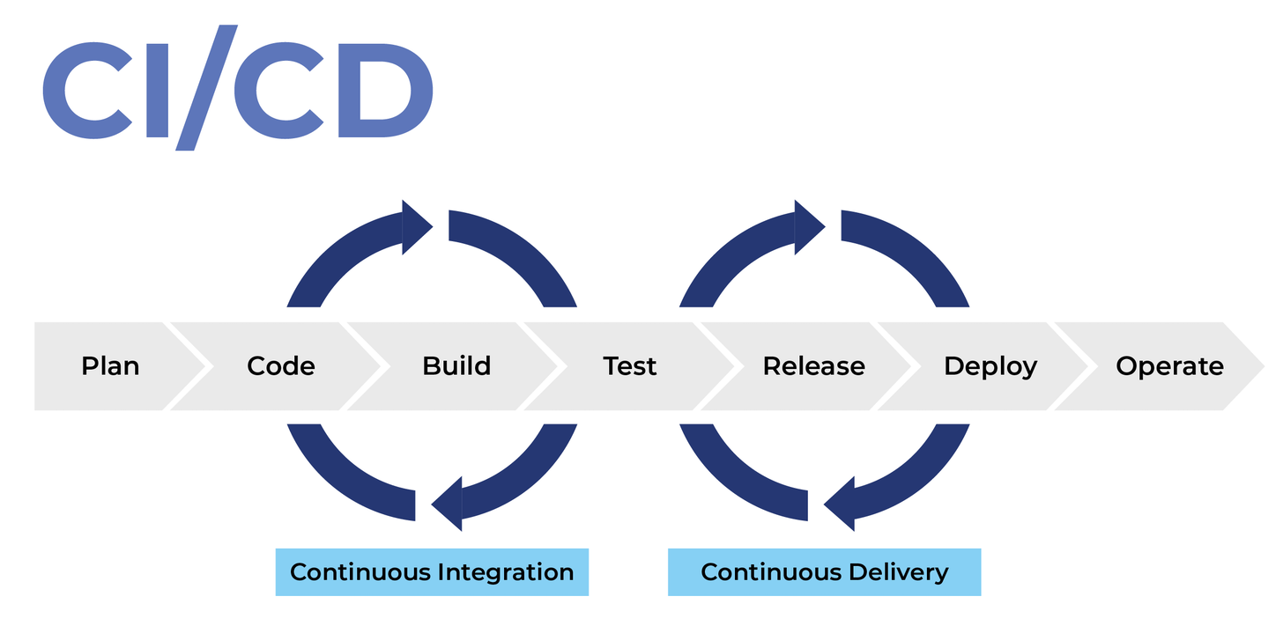

Slide 7


Slide 8
Benefits of CI/CD pipeline
CI/CD pipeline has more positive effects than simply making what was previously done a little bit more efficient:
Developers can stay focused on writing code and monitoring behavior of the system in production.
QA and product stakeholders have easy access to the latest version of the system.
Product updates are not stressful.
Logs of all code changes, test and deployments are available for inspection at any time.
Rolling back to a previous version in the event of a problem is a routine action.
A fast feedback loop helps build an organizational culture of learning and responsibility.

